Slide 1
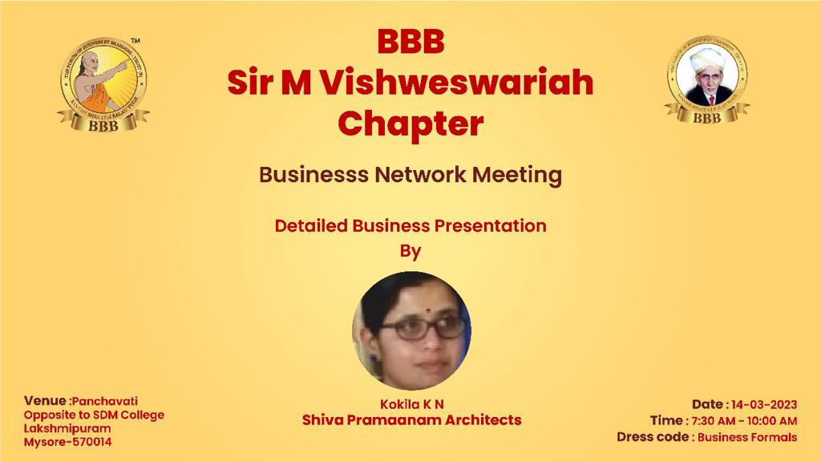

Slide 2
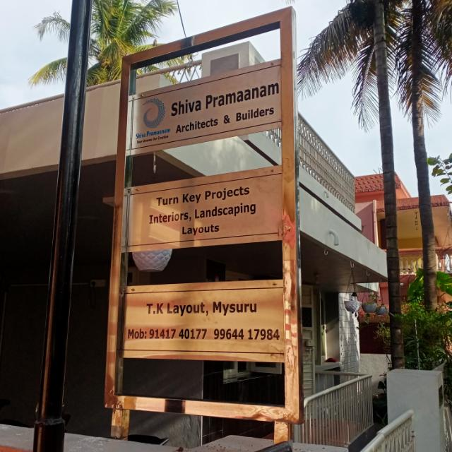
Shiva Pramaanam
Architects & Builders
Mrs Kokila K. N
Mobile No :
9964417984

Slide 3
Myths about Architects
Architects just design new buildings
Architects are only interested in big projects
Architects cost too much
Architects just care about how buildings look
Architects just work in the big cities
Architects just do drawings
Architects only work for rich people
Architects aren’t practical
Architects don’t listen.

Slide 4
Why You Should Hire- Shiva Pramaanam
Greater understanding of your needs
Better design overall
We avoid design errors
We provide creative ways to solve problems
You can save money
Good design is a profitable investment- Resale value
We help you choose the right materials and finishes
Integrated energy efficiency
Negotiations with your contractor

Slide 5
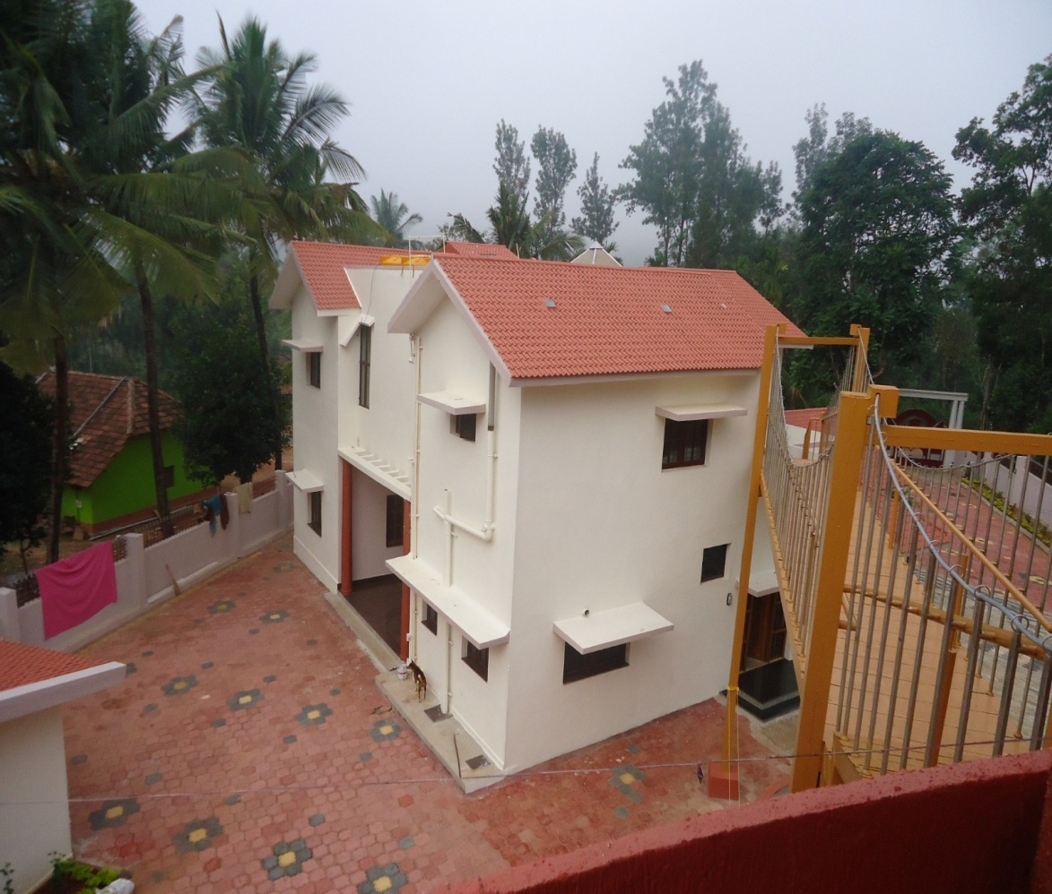
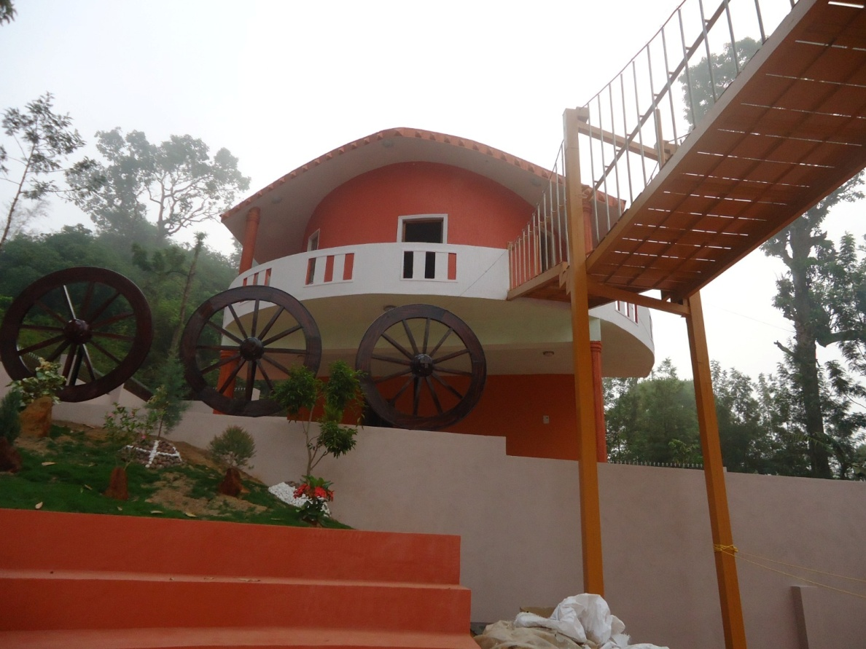
Farm House Project Near Chikkamagaluru

Slide 6
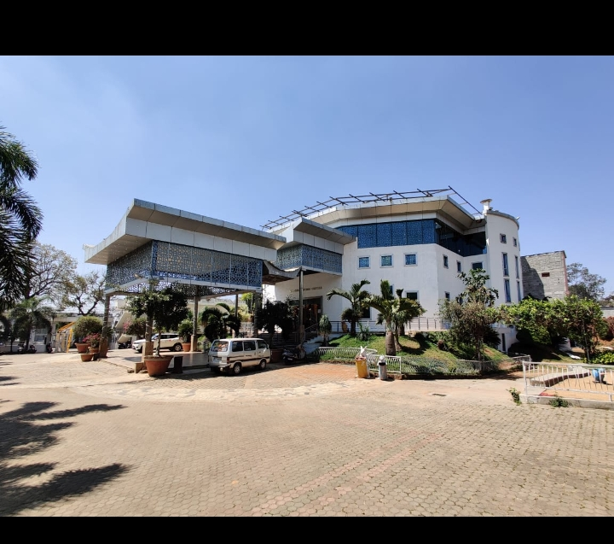
Convention Hall- Hassan

Slide 7
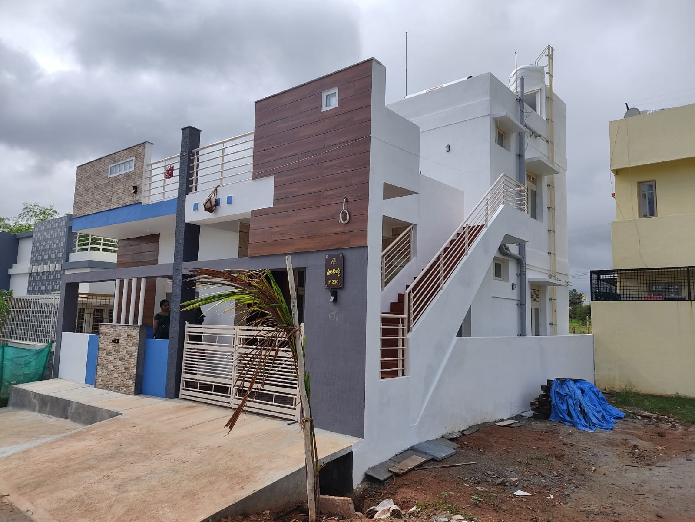
Residential Projects Mysore – Bangalore –Hassan ….

Slide 8
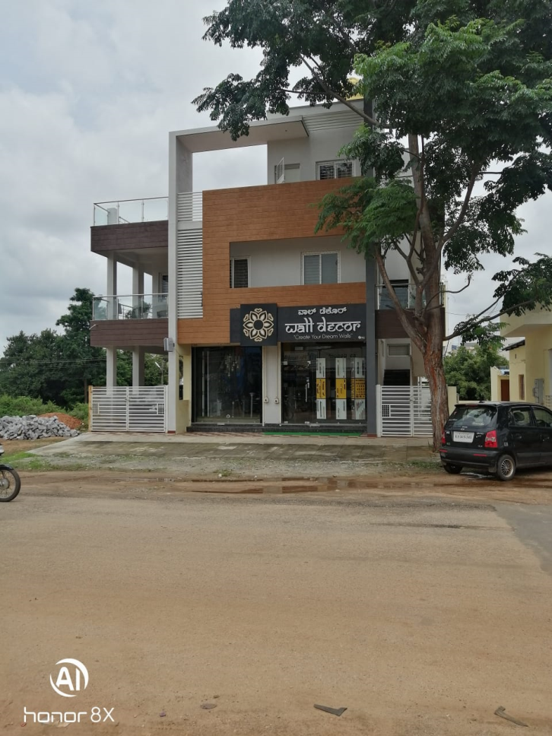
Residential and Commercial

Slide 9
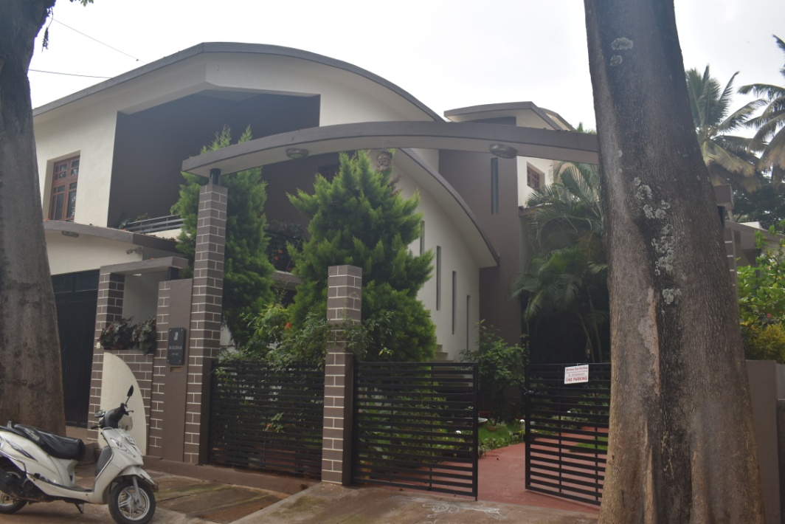
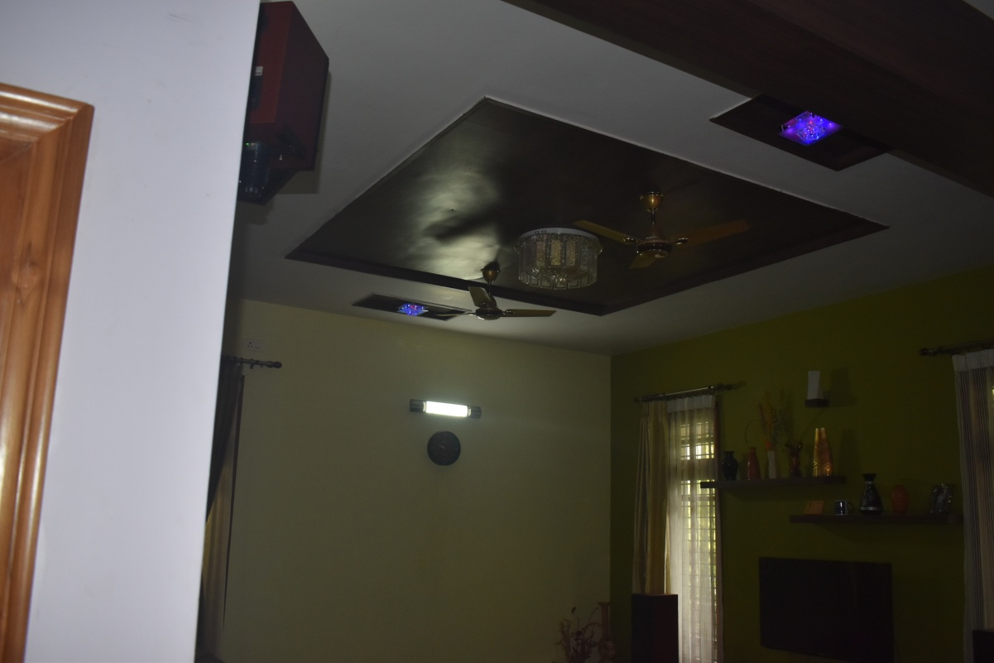
Landscape ,Form oriented Residence

Slide 10

Shiva Pramaanam Architects & Builders
Q&A

